Slide 1
ONLINE SAFETY · AWARENESS GUIDE
AWARENESS OF ONLINE SCAMS
Recognize the patterns that turn an ordinary message, call, or website into a costly mistake.
Batch – 13
C. Siddharth Rao - 24K81A05H8
S. Samvidha - 24K81A05h9
S. Naga Jyothi - 24K81A05J0
S. Sreeja - 24K81A05J2
Notes:
This guide is about slowing the moment down. Scammers want a fast reaction before you have time to check what is happening.

Slide 2
THE PATTERN
THE FOUR MOVES BEHIND MOST SCAMS
Most scams follow a familiar script.
01
02
03
04
Impersonate
Trigger
Rush
Demand
They pretend to be someone you know.
They create a problem or promise a prize.
They pressure you to act immediately.
They want a specific payment or secret.
Remember: These are core scam signals identified by the FTC.
Notes:
Point to the four moves from left to right. One signal may be explainable; several together should make you pause and verify.

Slide 3
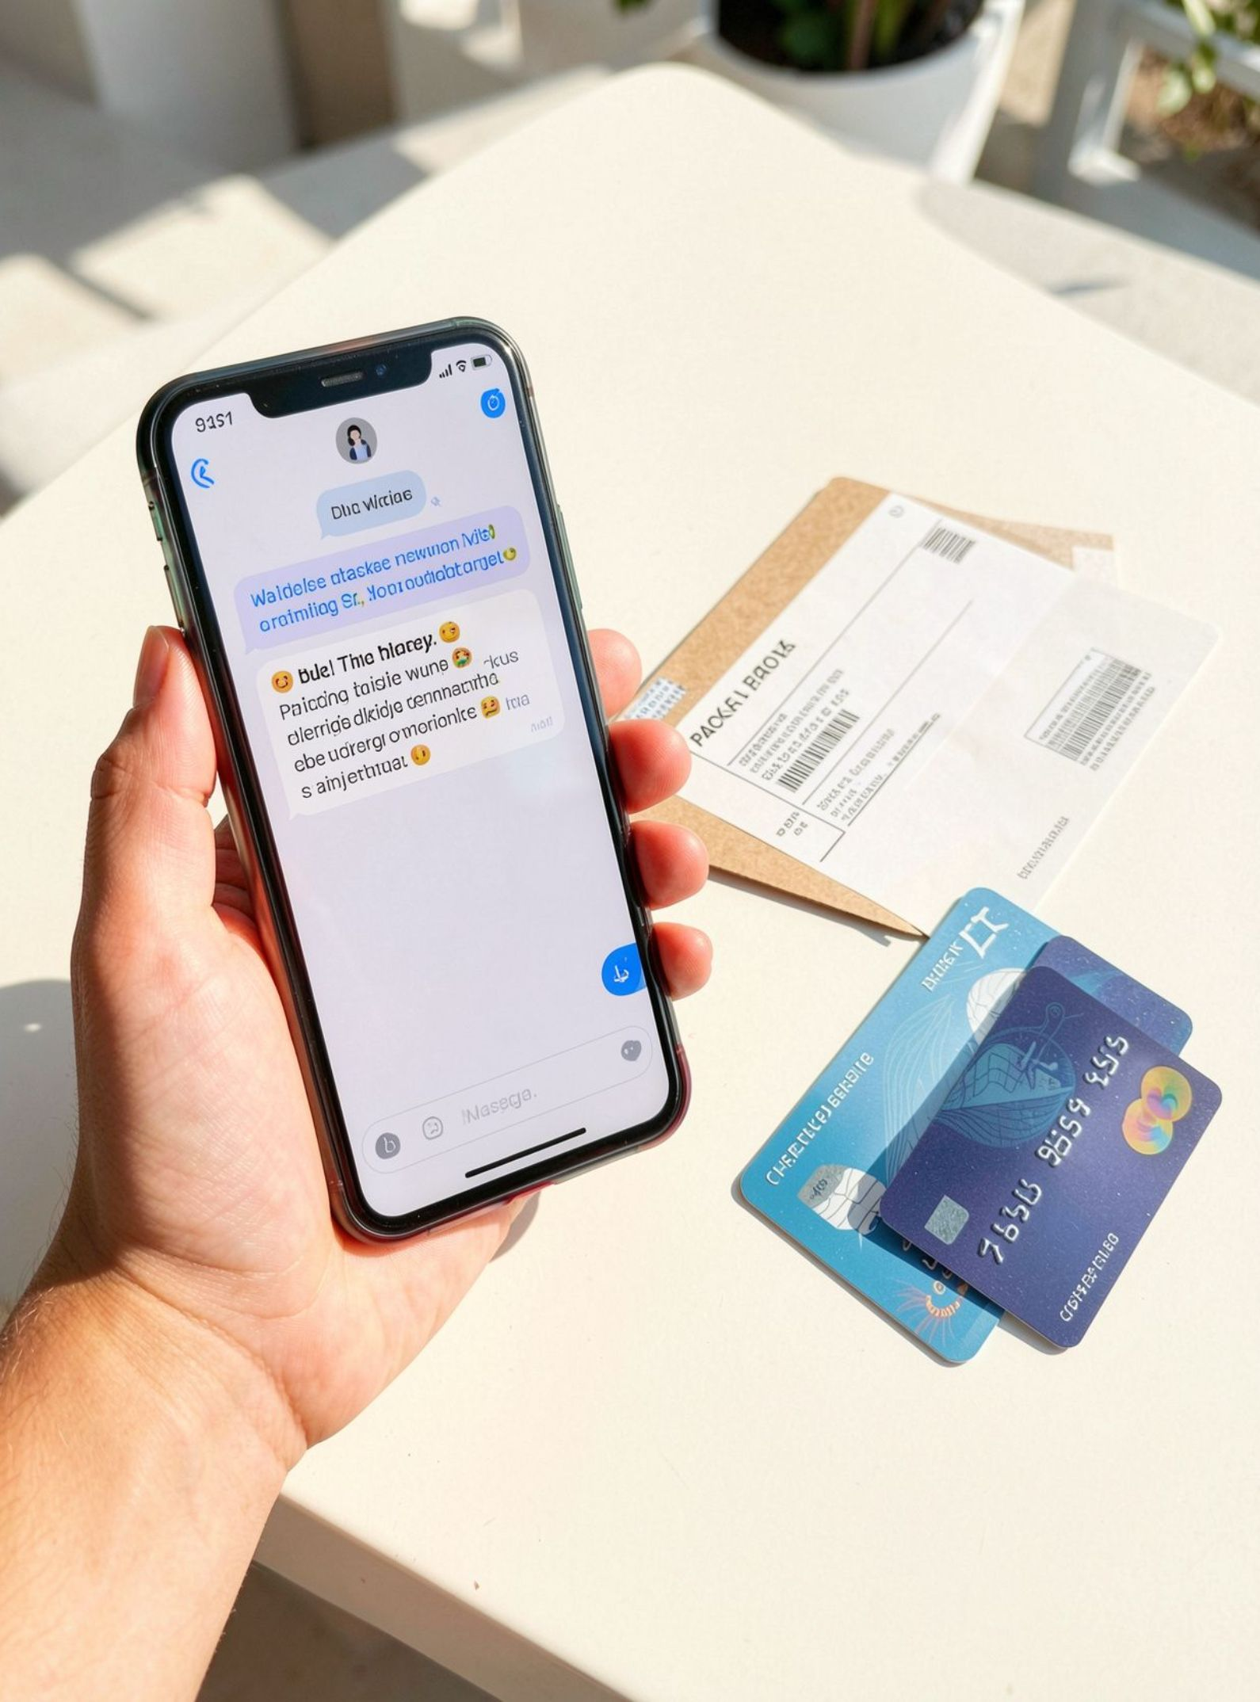
LOOKS REAL · ISN’T
PHISHING WEARS FAMILIAR CLOTHES
A fake message may look like it comes from your bank, employer, delivery service, or a friend.
It wants a click, login, attachment, or reply.
Phishing can arrive by email, text, social message, or phone call.
Notes:
Phishing is not one visual style. It borrows the clothes of services and people you already trust, then asks for a small action that gives the scammer access.

Slide 4
THE PRESSURE TEST
URGENCY IS THE TRAP
01
“Your account will be closed today.”
02
“You must pay before the deadline.”
03
“Don’t hang up while we fix this.”
04
“Keep this secret.”
Pressure is meant to stop you from checking the story.
Notes:
Read the examples aloud. Notice what they have in common: each one narrows your choices and tries to keep you from asking someone else.

Slide 5




VERIFY FIRST
CHECK THE SENDER, NOT THE LOGO
Inspect
Preview
Notice
Confirm
Check the full email address or phone number.
Hover over links before clicking.
Watch for look-alike domains and shortened URLs.
Use the organization’s official app or website.
Perfect spelling no longer proves a message is real.
Notes:
Logos and polished wording are easy to copy. The sender details and the route you use to verify are harder for a scammer to control.

Slide 6
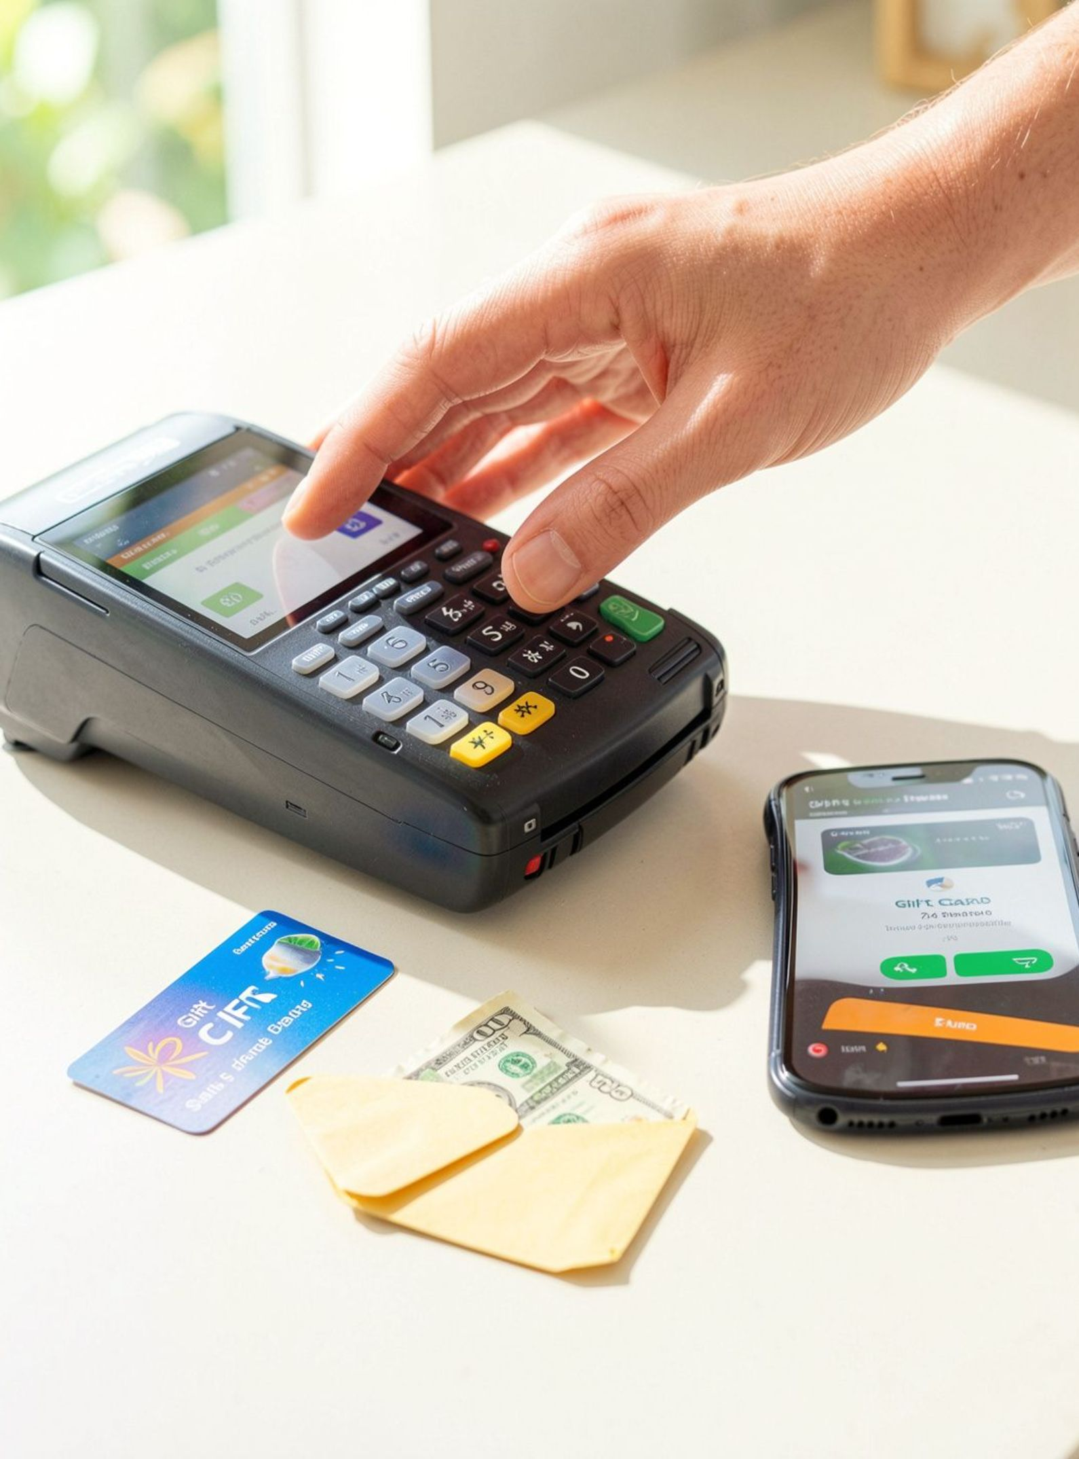
PAYMENT WARNING
NEVER LET A STRANGER CHOOSE YOUR PAYMENT
Crypto, gift cards, wire transfers, cash, and payment apps can be hard to reverse.
A demand for one specific method is a major warning sign.
Stop when the method feels forced.
Notes:
A legitimate organization may offer payment choices. A stranger who insists on one unusual method is trying to control the outcome.

Slide 7

THE STORY CHANGES
COMMON SCAM STORIES
Account alert
Delivery problem
Tech support
Romance or investment
“Verify your login.”
“Pay a small fee.”
“Your device is infected.”
“Trust me with your money.”
The story changes. The pressure pattern stays.
Notes:
These stories sound different because they target different hopes and worries. Ask what remains constant: the request arrives with pressure and a demand.

Slide 8
YOUR THREE-STEP RESET
STOP. CHECK. CHOOSE.
A ten-second pause can break the scammer’s rhythm.
01
02
03
Stop
Check
Choose
Don’t click, reply, or pay.
Verify through a separate official channel.
Continue only when the request makes sense.
Notes:
Practice the three words as a response. Stop the contact, check somewhere independent, and choose only after the request makes sense.

Slide 9




BEFORE TROUBLE STARTS
PROTECT YOUR ACCOUNTS BEFORE TROUBLE STARTS
Use unique passwords
Turn on MFA
Keep devices updated
Review alerts
Add a second proof that it is really you.
Notice unusual bank and account activity early.
Make each important account harder to unlock.
Install updates for devices and apps.
Make the safe choice the easy choice.
Notes:
These steps reduce the damage a scam can do. They are simple habits, and they work best when you set them up before a stressful message arrives.

Slide 10

IF SOMETHING HAPPENED
IF YOU CLICKED OR PAID, ACT FAST
01
Stop contact with the scammer.
02
Change exposed passwords and enable MFA.
03
Call your bank or payment provider using an official number.
04
Save messages, receipts, and account details.
Fast reporting can limit further damage.
Notes:
Do not spend time hiding what happened. Stop the contact, secure exposed accounts, call the real provider through an official route, and keep records.

Slide 11
WHEN A MESSAGE FEELS OFF
STOP → CHECK → CHOOSE
Use a three-step pause before you click, reply, or pay.
STOP
CHECK
CHOOSE
Pause. Do not click links, open files, or reply in the moment.
→
Verify the sender and request through a trusted route you find yourself.
→
Take the safe next step: ignore, report, or contact the real organization.
A pause breaks the pressure and gives you back the decision.

Slide 12


THE PRESSURE CYCLE
HOW SCAM PRESSURE MOVES YOU TOWARD ACTION
Each step narrows your choices. Interrupt the cycle before the demand becomes a decision.
Conceptual awareness graphic · pressure rises across the sequence; this is not measured data.
Interrupt it: stop, verify independently, and choose your next step without the sender directing you.

Slide 13
THANK YOU

